Slide 1


Chapter 53: Your Job? My Reputation!
By Group 2:
Nidhishree Sanam
Shwetha Reddy Reddymalli
Sai Gangadhar Veeramreddy
Sai Manoj Kalasani
Sravani Ravulaparthi

Slide 2

Characters in the story
Story Recap
Stanley – Student of Dept.
Dr. Faust – Chairman of Dept.
Sherman March – Student of Dept.
Stanley is discussing frustrations of experiences with upper management, with a young assistant in the burgeoning Management Trainee Program.
As a result of this conversation, Stanley begins reflecting on his instructional episodes and the primary one that stands out is one that involves Dr. Faust.
Stanley was named to lead a project and a main reason why he was awarded the project was because of the strong recommendation he received from Dr. Faust, his mentor.
Stanley worked to set a clear description of the project and the results that were expected.
Mr. Marsh approved the project as Stanley presented but New York begins demanding results only 8 months into the project, when Stanley projected years.
Stanley is willing to put his job on the line and push back to reset expectations, but Dr. Faust feels that Stanley not delivering the results New York is asking for will now tarnish his reputation in the organization.

Slide 3

Managerial Lessons learned
Your attitude determines your entire life.
Take Constructive criticism seriously.
Maximize the principles of common courtesy.
Keep a flexible mindset.
Believe in yourself and visualize your goals to see how small your
problems are.

Slide 4


Theories
Organization Culture
Shared views, values, and attitudes developed by leaders within the organization defines organizational culture, which in turn shapes how employees behave and perceive in the organization.
Coaching Skills
Effective coaching skills are developed to help others in achieving personal and professional goals.
Attending - being the company of someone else with full attention
Acknowledging - bringing out the best
Querying - proactive questions
Reflecting - prompts further exploration
Indicating respect - communicating trust
Self - disclosure - sharing information

Slide 5
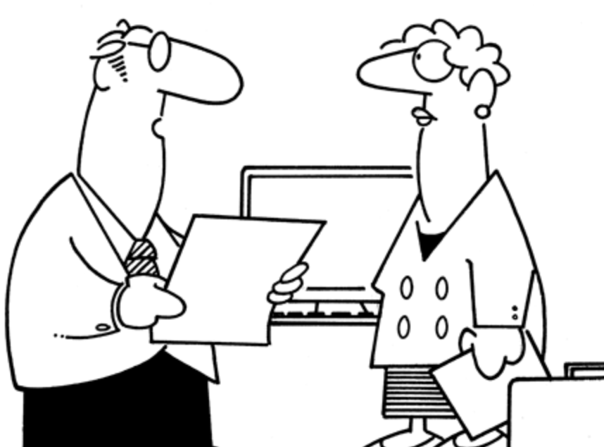
Additional Research
The current story reflects a clear sign of Ego Affliction. In a recent study by Deloitte and Forbes Insights, 300 executives (C-suite and board directors) were surveyed. One revelation? They consider reputation as the highest strategic risk area for a company.
In the fall of 2012, management consulting firm McKinsey published McKinsey Business and Technology – Delivering large-scale IT projects on time on budget and on value.

Slide 6

References:
The ropes to skip and the ropes to know_ studies in organizational theory and behavior-Chicago Business Press
https://umbc.hosted.panopto.com/Panopto/Pages/Viewer.aspx?id=00372a39-b835-4006-9e43-ac5200ea8102
https://www.projectmanagement.com/contentPages/article.cfm?ID=289408&thisPageURL=/articles/289408/Project-Failures---Reputation-Risk#_=_

